Slide 1
Amazon bookstore database
ITeam-Qianhui Guo, Han Li, Ying Xue

Slide 2

Necessity Analysis and Problem solved
Efficiently Store , Manage, Retrieve and Analyze millions of customers’ daily order records and their personal information, we create 9 relational tables about books, customers, orders , purchases ,publishers, group, format information for Amazon bookstore.
to prevent overstock and understock
accurate, updated and synced data
to store order records and analyze customers’ preferences
the hardcopy/paperback books
the trend of the audio and kindle book subscribed
the profit of each book(e.g. Total price spread between purchase and sales records, etc)
to be used for data mining and integrated to other automatic systems in the future
demand, marketing forecast
Automatic checkout system
Payment, shipment system

Slide 3
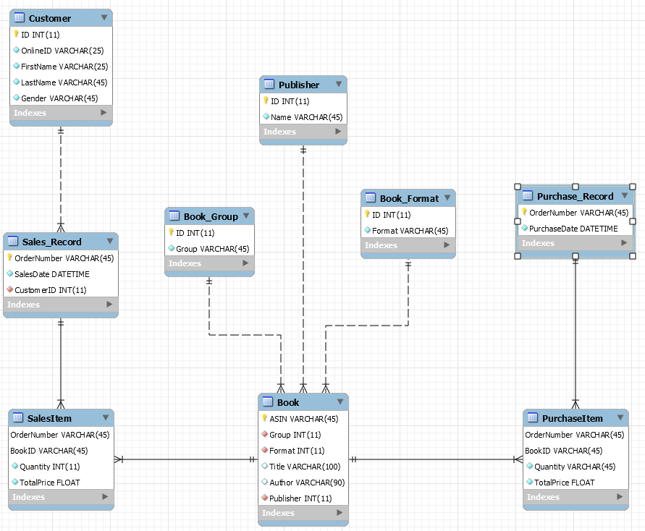
Amazon bookstore database schema
Notes:
Customer has a one to many relationship with Sales_record, because one customer is allowed to place multiple orders within a day but the same order can’t be placed by different customers or online users. Sales_record has a many to many relationship with the book because within one order customer can order different books, and the same book can be ordered in different orders.
And these two tables are linked by the SalesItem table, with OrderNumber and BookID as the composite primary key.
It’s in the same case with the Purchase_Record and the book, the book store may order the same book in different orders, and within the same order, the book store can order different books vice versa. And these two tables are linked by the PurchaseItem table, with OrderNumber and BookID as the composite primary key.
Book has a many to one relationship with Publisher, Book_Format, Book_Group for the simple reason that multiple books can be published by the same publisher and share the same Book Format and Book Group, while each book can only one publisher and belongs to a single format and group.

